Slide 1
INTRODUCTION OF COMPUTING

Slide 2
COMPUTER SYSTEMS
A Computer is an electronic device that stores, manipulates and retrieves the data.

Slide 3
COMPUTER SYSTEMS
The following are the objects of computer System
User ( A person who uses the computer)
Hardware
Software

Slide 4
HARDWARE
Hardware is any part of your computer that has a physical structure, such as the keyboard or mouse.
Hardware is anything which is tangible .

Slide 5
SOFTWARE
Set of instructions that tells the hardware what to do and how to do it.

Slide 6
INPUT/OUTPUT DEVICES
https://www.youtube.com/watch?v=JG_pea_aqpQ
https://www.youtube.com/watch?v=qnQyFIHqiKY

Slide 7
MEMORY vs STORAGE
https://www.youtube.com/watch?v=WZtHkRu2q58

Slide 8
RAM vs ROM
https://www.youtube.com/watch?v=_S8C9hRUYFQ

Slide 9
Why we study Programming Language?
If you are a Student of any computer field or just a student, you must have seen people working with Tech Giants like FACEBOOK , AMAZON , NETFLIX, GOOGLE or simply say FANG companies. Ever wondered how they got there?
They didn't went there by just getting a degree.
For getting selected in these companies, one should be aware of all the concepts of programming (From basic to advance).

Slide 10
COMPUTER LANGUAGES
1940‘s -- Machine Languages
1950‘s -- Symbolic Languages
1960‘s -- High Level Languages

Slide 11
Machine Language
Each computer has its own machine language which is made of streams of 0‘s and 1‘s.

Slide 12
Machine Language
Advantages:
High speed execution
The computer can understand instructions immediately
No translation is needed.
Disadvantages:
Machine dependent
Programming is very difficult
Difficult to understand
Difficult to write bug free programs
Difficult to isolate an error

Slide 13
Symbolic Languages (or) Assembly Language
These early programming languages simply mirrored the machine languages using symbols or mnemonics to represent the various language instructions.
Like: assembly Language

Slide 14
Symbolic Languages (or) Assembly Language
Advantages:
Easy to understand and use
Easy to modify and isolate error
High efficiency
More control on hardware
Disadvantages:
Machine Dependent Language
Requires translator
Difficult to learn and write programs
Slow development time
Less efficient

Slide 15
High-Level Languages
High-level languages are portable to many different computer allowing the programmer to concentrate on the application problem.
Like: C, C++, Java

Slide 16
High-Level Languages
Advantages:
Easy to write and understand
Easy to isolate an error
Machine independent language
Easy to maintain
Better readability
Low Development cost
Easier to document
Portable
Disadvantages:
Needs translator
Requires high execution time
Poor control on hardware
Less efficient

Slide 17
Difference between Machine, Assembly, High Level Languages
Feature | Machine Language | Assembly Language | High level Language
Form | 0‘s and 1‘s | Mnemonic codes | Normal English
Machine Dependent | Dependent | Dependent | Independent
Translator | Not Needed | Needed(Assembler) | Needed(Compiler)
Execution Time | Less | Less | High
Nature | Difficult | Difficult | Easy

Slide 18
Why C?
1. C is the language which start from scratch and it has all foundational concepts on which today's concepts are based.
2. C is unbeatable, when we talk about speed of execution.
3. Many programming languages are driven from C.
4. If you want to create your own OS, you have to learn C. Bcoz famous OS like windows, ios, linux and unix have thier major part written in C language .

Slide 19
Why C?
5. The most important reason to learn C is to learn "POINTERS". It was one of the amazing and useful concept of C language. Device Drivers of new devices are always written in C , because C provide direct access to memory of CPU by the help of pointers.

Slide 20
TRANSLATORS
Compiler
Assembler
Interpreter

Slide 21
COMPILER
https://www.youtube.com/watch?v=Vi8npxRMGac

Slide 22
Compiler vs Interpreter vs Assembler
https://www.youtube.com/watch?v=wE7SN8E-CoA

Slide 23
Language Translators
Compiler: It is a program which is used to convert the high level language programs into machine language
Assembler: It is a program which is used to convert the assembly level language programs into machine language
Interpreter: It is a program, it takes one statement of a high level language program, translates it into machine language instruction and then immediately executes the resulting machine language instruction and so on.

Slide 24
Compiler vs Interpreter
COMPILER | INTERPRETER
A Compiler is used to compile an entire program and an executable program is generated through the object program | An interpreter is used to translate each line of the program code immediately as it is entered
The compiled programs run faster | The Interpreted programs run slower
Most of the Languages use compiler | A very few languages use interpreters.

Slide 25
LINKER & LOADER
https://www.youtube.com/watch?v=cJDRShqtTbk

Slide 26
STEPS TO CREATE SOURCE CODE
Open a Text Editor
Create new file
Type the program instructions
Save the file with “.c” extension.

Slide 27
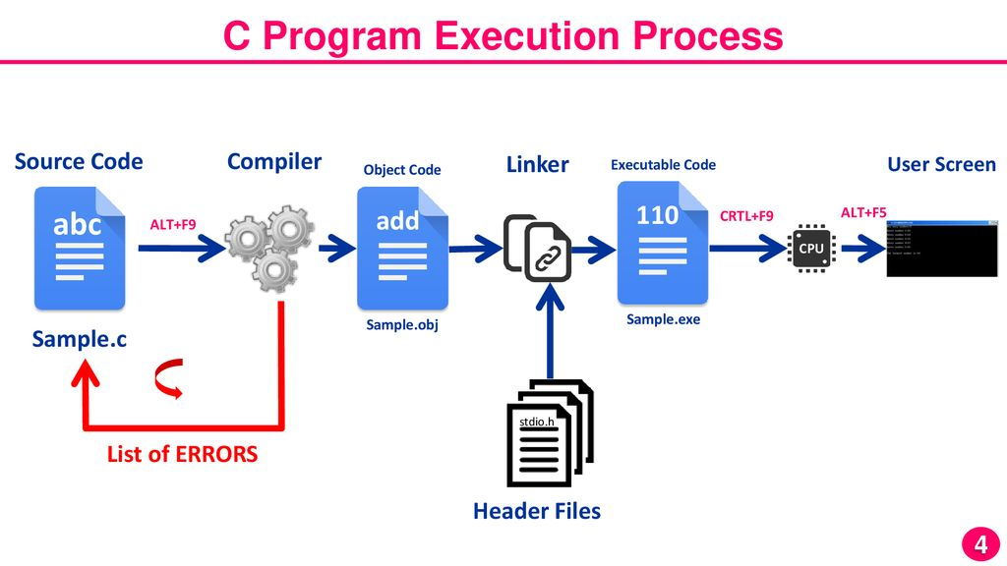
C PROGRAM EXECUTION PROCESS

Slide 28
STANDARD INPUT OUTPUT
https://www.youtube.com/watch?v=u50-0AWdX5s

